Slide 1


COVID DATA
BY:
SMRITHI MOHAN
UNNATI
DIVYA RAKSHITA
YASHWANTH

Slide 2

Table of
CONTENTS
01
02
03
04
OVERVIEW
KPI
DASHBOARDS
INSIGHTS

Slide 3

OVERVIEW
Understanding the Impact of COVID-19: Analysing the Data and Its Effects on Society.
COVID-19 is a term that has become a part of our daily vocabulary over the past few years, and its impact has been nothing short of revolutionary. In this presentation, we will provide an overview of the data collected, as well as the individuals and sectors that have been most impacted by it.

Slide 4

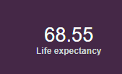
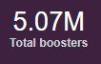
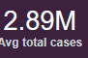
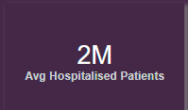
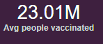
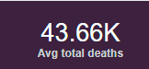
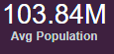
KPI’S

Slide 5
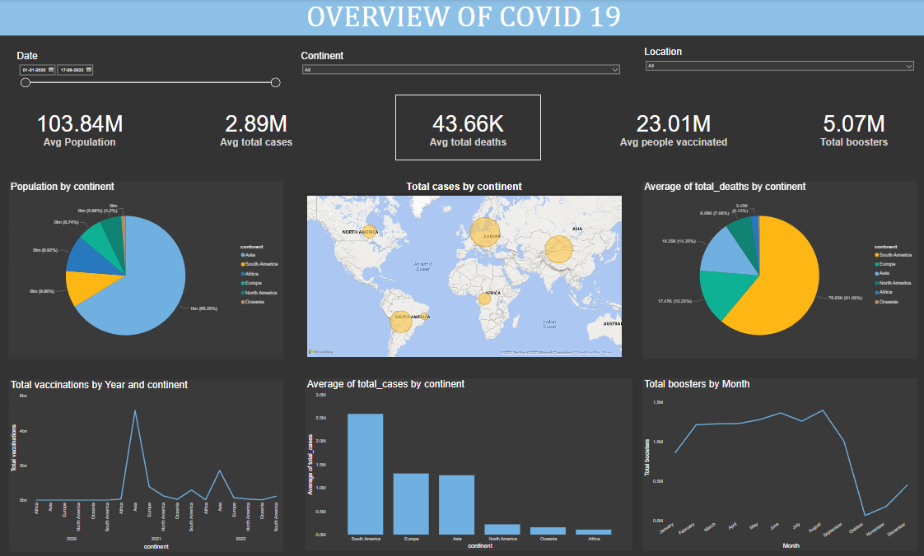

Slide 6
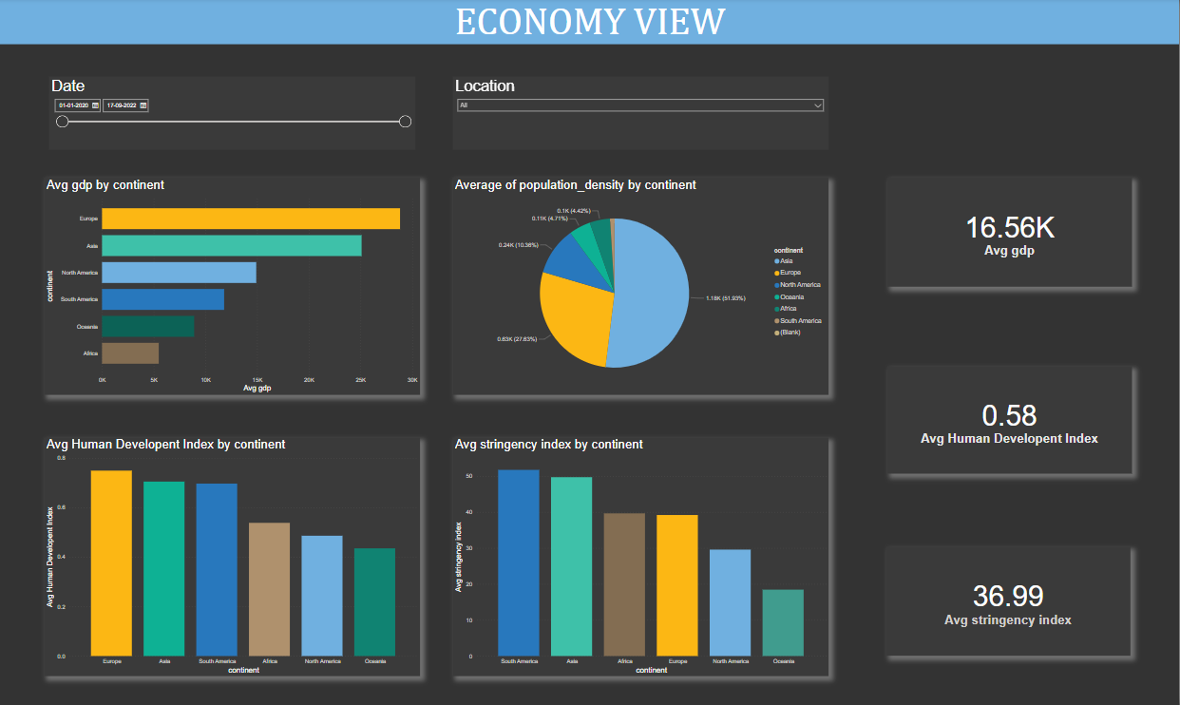

Slide 7
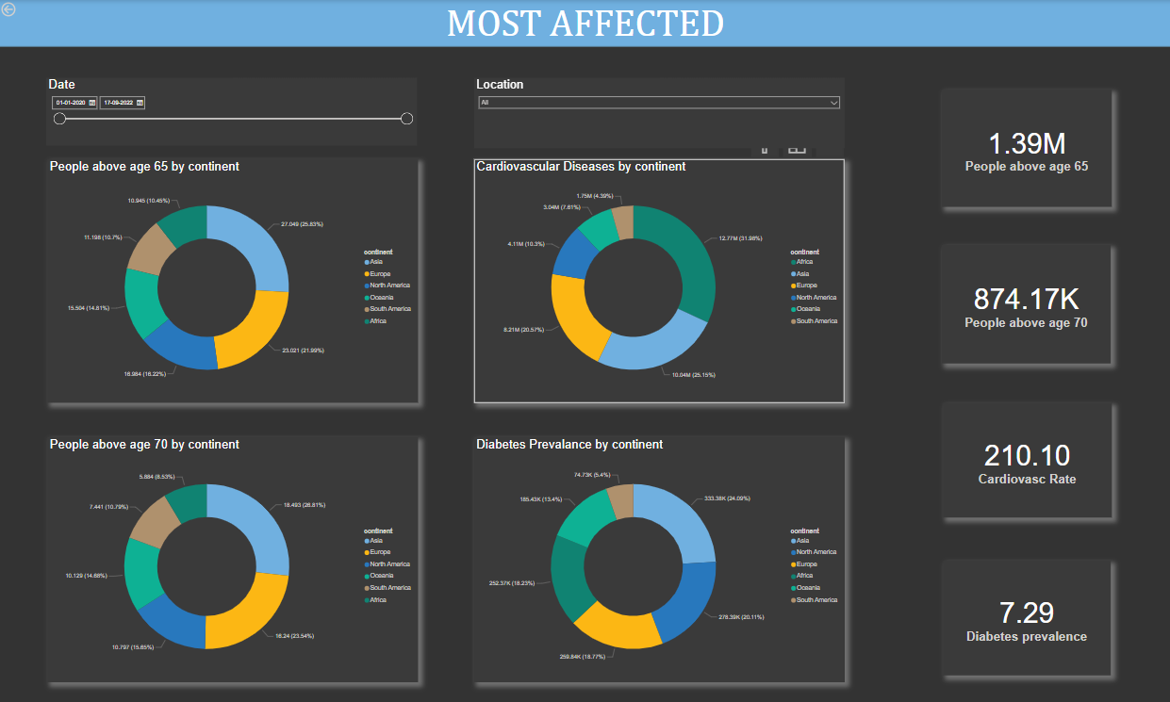

Slide 8
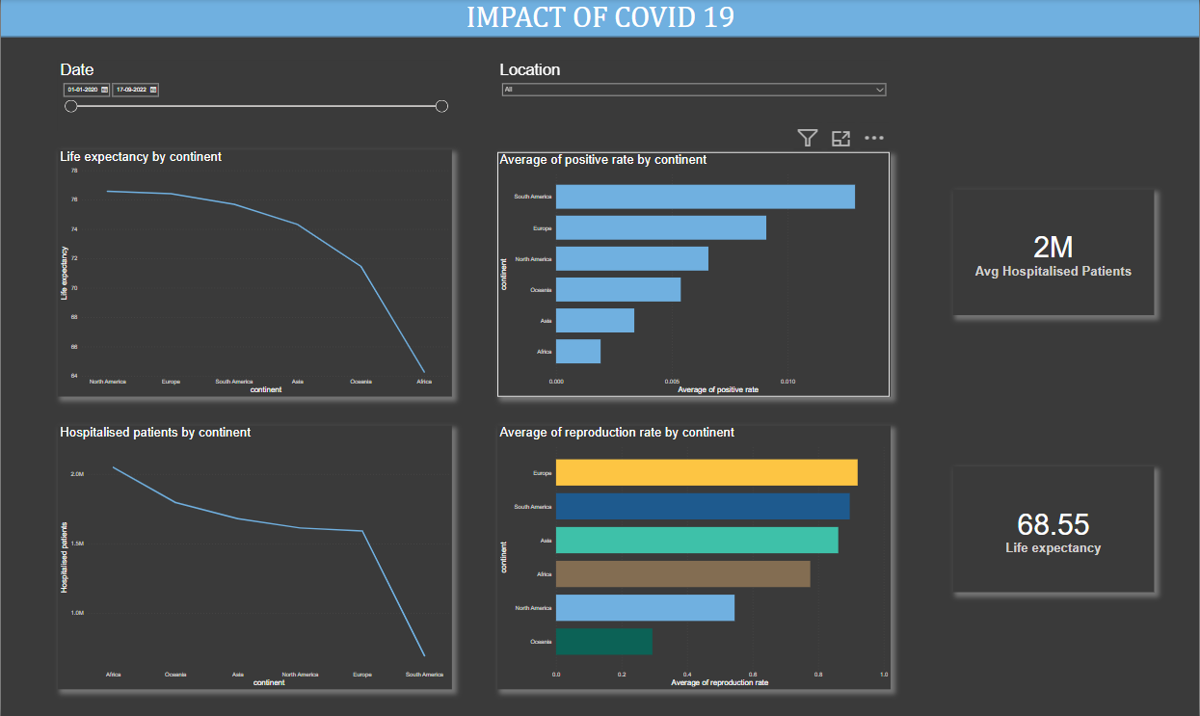

Slide 9


INSIGHTS
Here's a breakdown of some key COVID-19 statistics and their impact around the world:
2021 recorded the highest number of vaccinations administered.
South America had the highest number of deaths due to the virus.
South America also had the highest number of average cases.
Europe had the highest number of hospital patients admitted.
GDP across the six continents ranged from 5,485.24 to 28,815.54.
The elderly and those with cardiovascular diseases were the most affected groups.
South America had the highest positive rate, while Europe had the highest reproduction rate.
Post-COVID, life expectancy is estimated to be up to 68 years.
It's important to note that these statistics are constantly changing and evolving as the world continues to battle COVID-19. While it's encouraging to see that vaccinations are being administered at record rates, it's heartbreaking to see the impact of the virus on different regions and populations. The numbers serve as a reminder of the importance of continuing to follow guidelines and protocols to keep ourselves and others safe. As we move forward, it will be crucial to prioritize global efforts to mitigate the spread of the virus and provide support for those who have been affected. Let's work together towards a healthier, safer future for all.

Slide 10
THANK YOU

